Slide 1
Python week 4
Canberra Chinese School Sem1

Slide 2
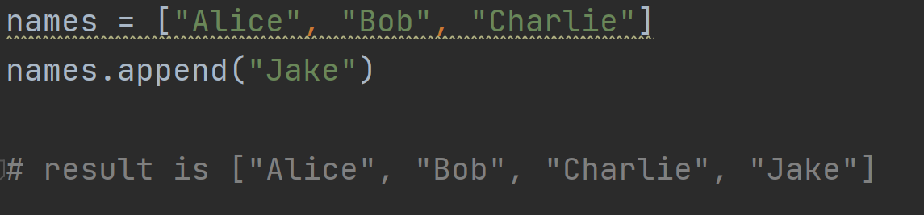
Review
For i in list:
do something

Slide 3
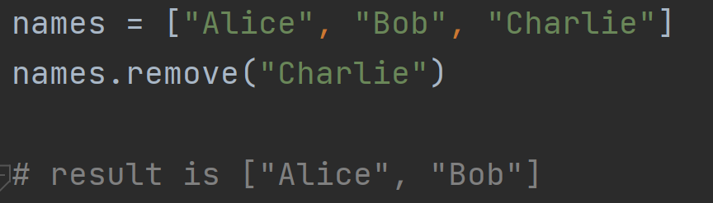
Review
For i in list:
do something

Slide 4
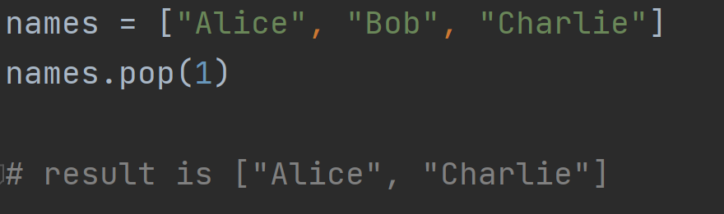
Review
For i in list:
do something

Slide 5

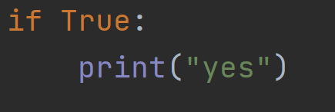
If statements
Press “tab”, then type print.
Indentation is important!

Slide 6
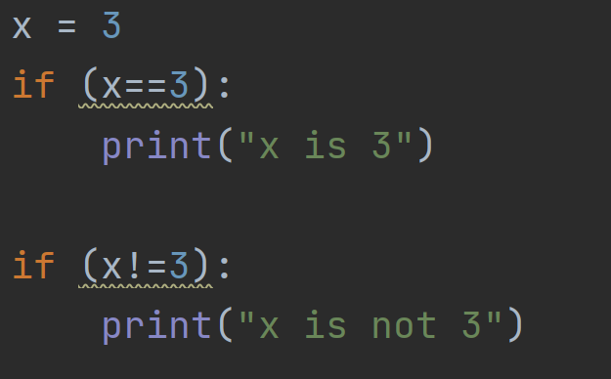
If statements

Slide 7
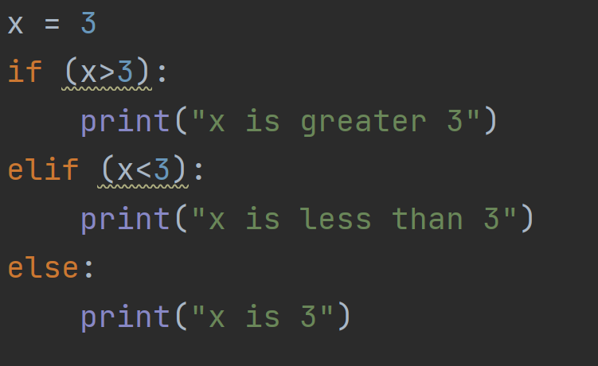
If statements

Slide 8
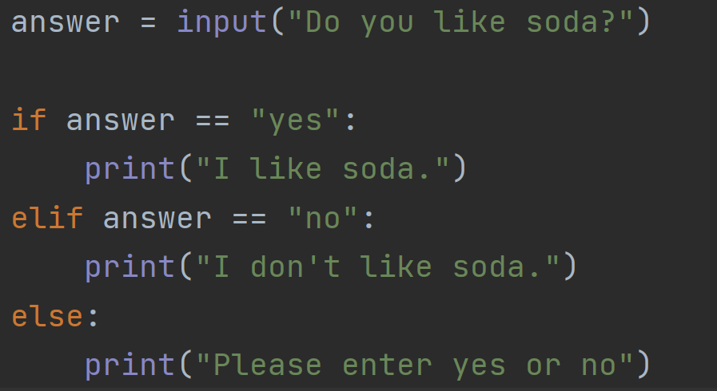
If statements

Slide 9
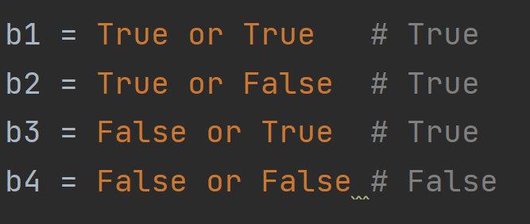
Logical Operators:or
True if one of two is true

Slide 10
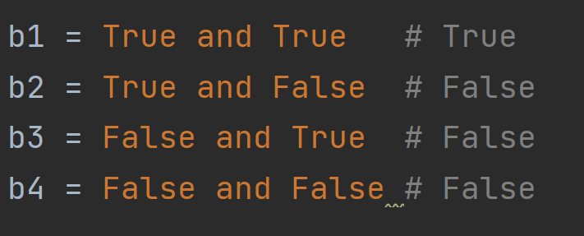
Logical Operators:and
False if one of two is false

Slide 11
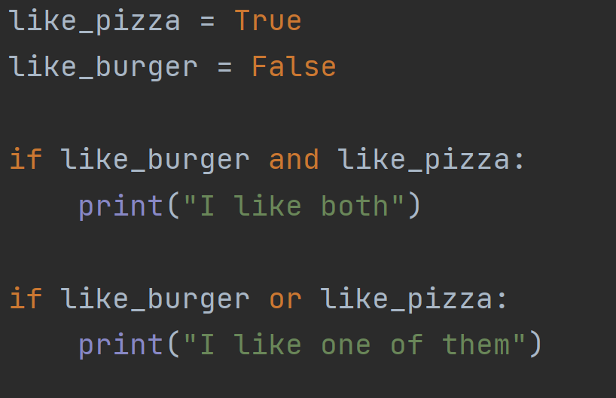
Logical operators
names[n] denotes the index n element, or the
(n+1)th element in the list

Slide 12
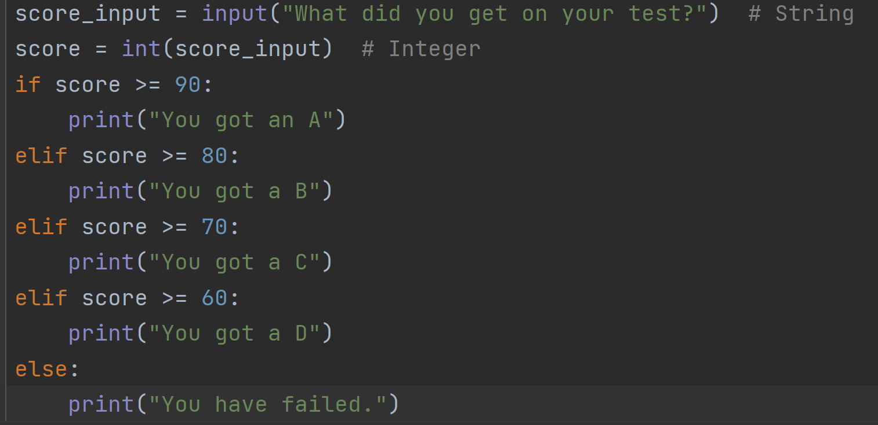
Program example

Slide 13
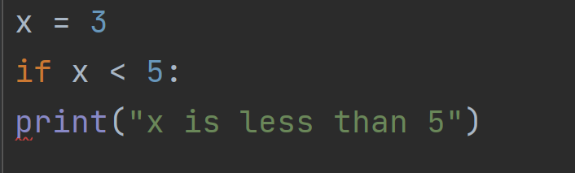
Quiz 1
Spot the error.
What is wrong with this code?
Answer: “print” should be indented.
(indented means you should have some spaces (a tab) in front”

Slide 14
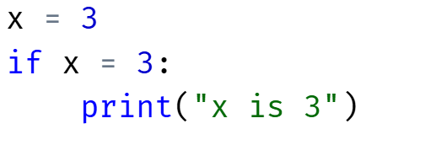
Quiz 2
Spot the error.
What is wrong with this code?
Answer: should be “if x == 3”

Slide 15
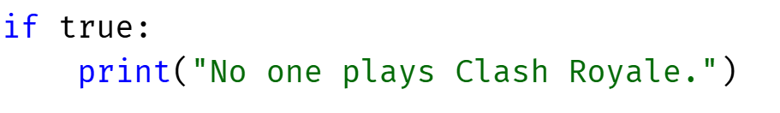
Quiz 3
Spot the error.
What is wrong with this code?
Answer: should be “True” with the capital letter T

Slide 16

Quiz 4
Answer: A
What is x
A. True
B. False

Slide 17
Quiz 5
Answer: A
What is x
A. True
B. False

Slide 18
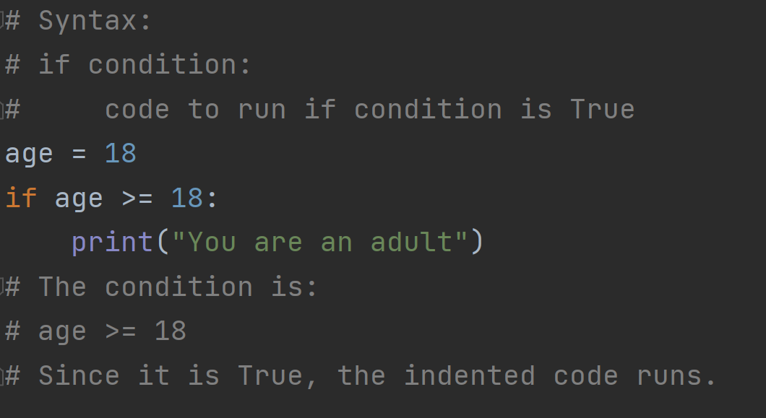
Summary

Slide 19
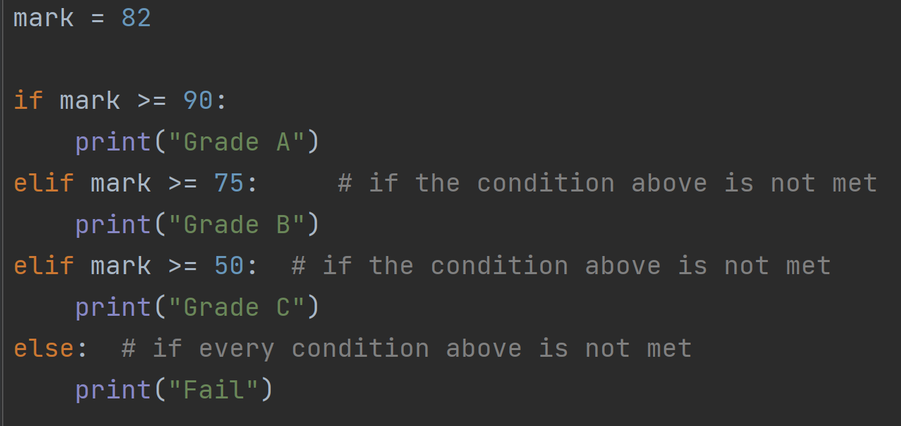
Summary

Slide 20
Important Notes
# 1. Indentation matters in Python.
# The indented lines belong to the if statement.
# 2. A colon (:) must be written after
# if, elif, and else.
# 3. Conditions return either:
# True or False

Slide 21
Comparison Operators
== equal to
!= not equal to
> greater than
< less than
>= greater than or equal to
<= less than or equal to

Slide 22
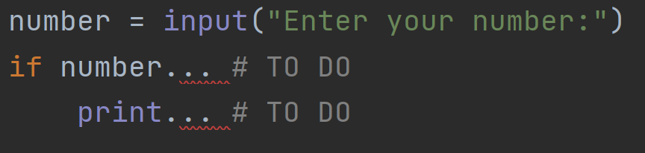
Exercise1
Make a program that checks if a number is positive.
Note: what variable type is number? Can we compare a string with an integer?

Slide 23
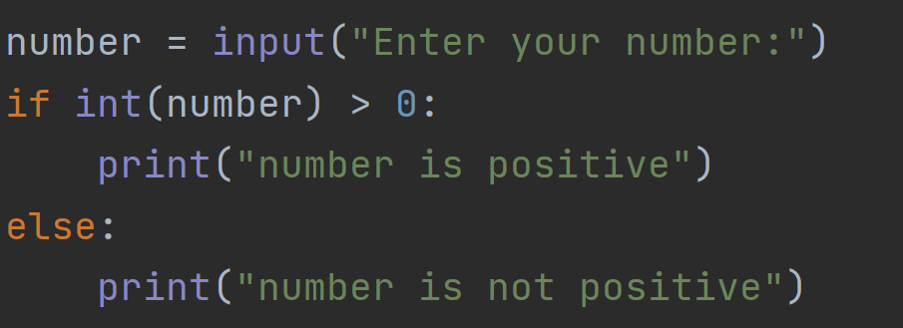
Exercise1 answer
Make a program that checks if a number is
Positive.

